Slide 1

Decision Tree
Machine Learning Classification with Titanic Dataset

Slide 2

Table of Contents
1
Introduction of Decision Tree
4
Exploratory Data
Analysis
Basic information of Decision Trees
Explore the dataset to gain insight
2
Gini Impurity
5
Modelling
Understanding basic concept of Gini Impurity
Applying Decision Tree Model
3
Data Understanding
6
Model Evaluation
Understanding the given dataset
Evaluate the model performance

Slide 3

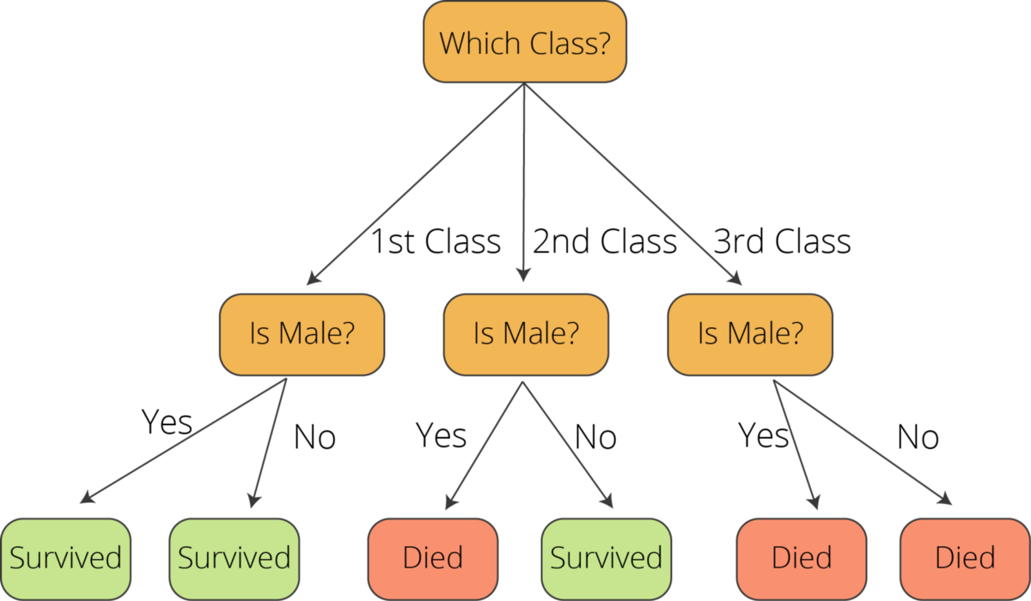
What is Decision Trees?
Decision Tree is a non-parametric supervised learning method used for classification and regression. The goal is to create a model that predicts the value of a target variable by learning simple decision rules inferred from the data features. (Source : Scikit-Learn)
Decision trees can be used for both predicting numerical values (regression) and classifying data into categories. Decision trees use a branching sequence of linked decisions that can be represented with a tree diagram. (Source : IBM)
(Source : towardsdatascience.com)

Slide 4

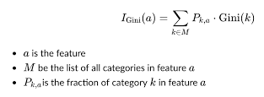
Gini Impurity
Gini Impurity is a measurement used to build Decision Trees to determine how the features of a dataset should split nodes to form the tree. More precisely, the Gini Impurity of a dataset is a number between 0-0.5, which indicates the likelihood of new, random data being misclassified if it were given a random class label according to the class distribution in the dataset.
(Source : learndatasci.com)

Slide 5
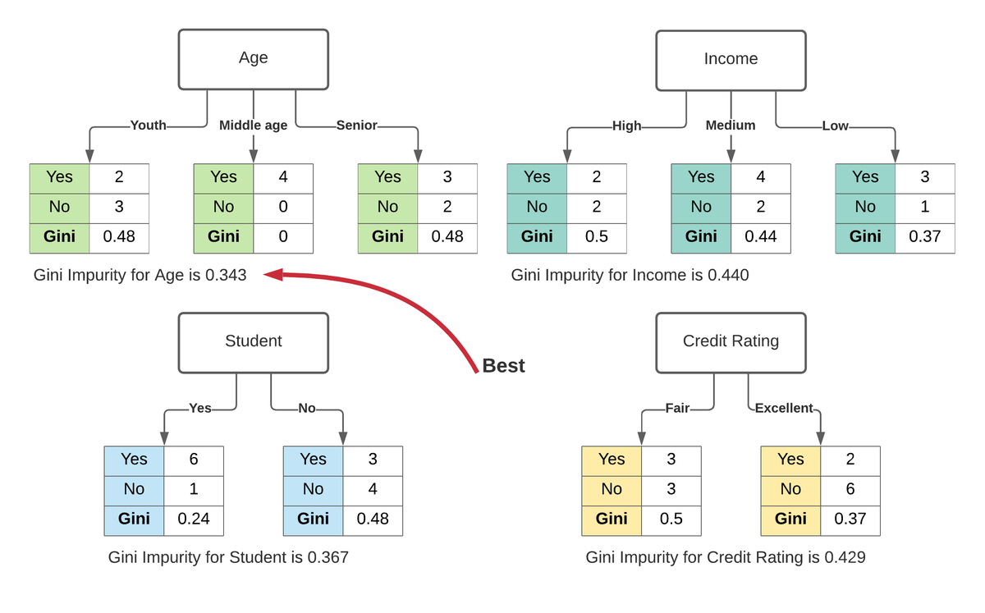
Gini Impurity
(Source : learndatasci.com)

Slide 6
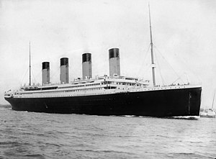
Data Acquisition
The Titanic - Machine Learning from Disaster dataset was obtained from kaggle.com.
The dataset includes information about:
Passenger’s Age – the column is called age
Passenger type of class – the column is called pclass
Proportion of male and female – the column is called gender
Specific cabin location for each passenger – the column is called cabin
(Source : Titanic RMS on Wikipedia)

Slide 7

Data Understanding
The Titanic - Machine Learning from Disaster Attribute Information :
NO | COLUMNS | DESCRIPTION
1 | survived | Survival
2 | pclass | Ticket class
3 | sex | Sex
4 | Age | Age in years
5 | sibsp | Siblings / spouses aboard the Titanic
6 | parch | Parents / children aboard the Titanic
7 | ticket | Ticket number
8 | fare | Passenger fare
9 | cabin | Cabin number
10 | embarked | Port of Embarkation

Slide 8

Exploratory Data Analysis
Let’s explore our dataset!

Slide 9

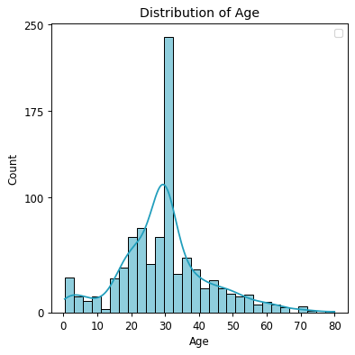
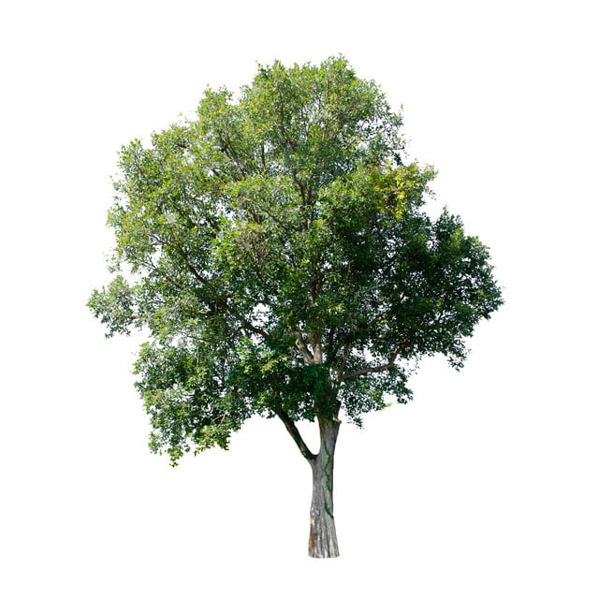
Distribution of Passenger Age
Based on the histogram chart, we can see that most of the passenger are in the range of 20 - 40 years old.

Slide 10
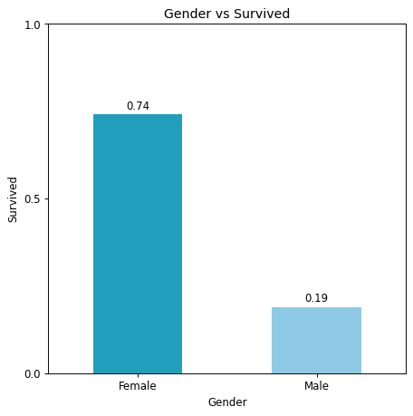
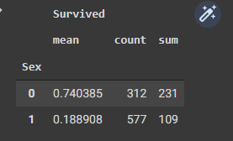
Survived vs Gender
Since "Survived" is a binary class (0 or 1), these metrics grouped by the Title feature represent:
MEAN : survival rate
COUNT : total observations
SUM : people survived
By looking at the chart we can infer that female has the average survival rate of 0.85 and male has only 0.32. Which means female has higher rate of survival than male.

Slide 11
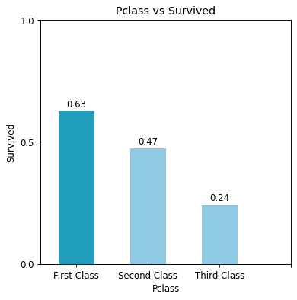
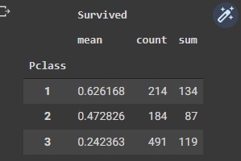
Survived vs Class
The bar chart shows that comparison of survival rate grouped by passengers type of class. Passengers seated in the first class have higher survival rate than the other, which is 0.63. Meanwhile passengers seated in the third class have the lowest survival rate, which is 0.24.

Slide 12
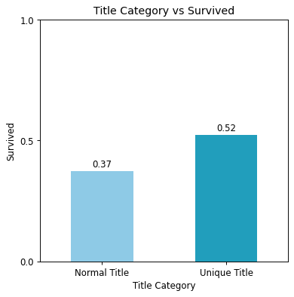
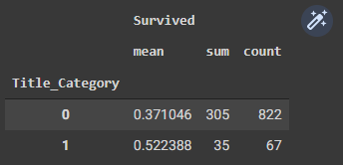
Survived vs Title Category
The chart shows comparison of survival rate based on title category. Normal title like 'Mr’, 'Miss’ , and ’Mrs’ have lower survival rate than unique title which is 0.37. In the other side, those who got unique title like “Master”, “Dr”, etc, have higher rate survival which is 0.52.

Slide 13
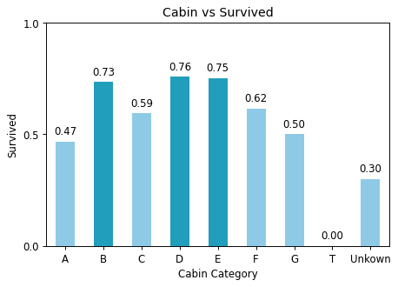
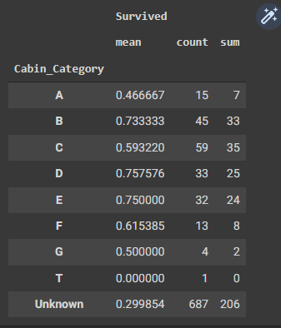
Survived vs Cabin
From the bar chart we can see that passengers seated on cabin B, D, and E have higher rate of survival than the other cabin.

Slide 14
Modelling
Let’s try our model!

Slide 15

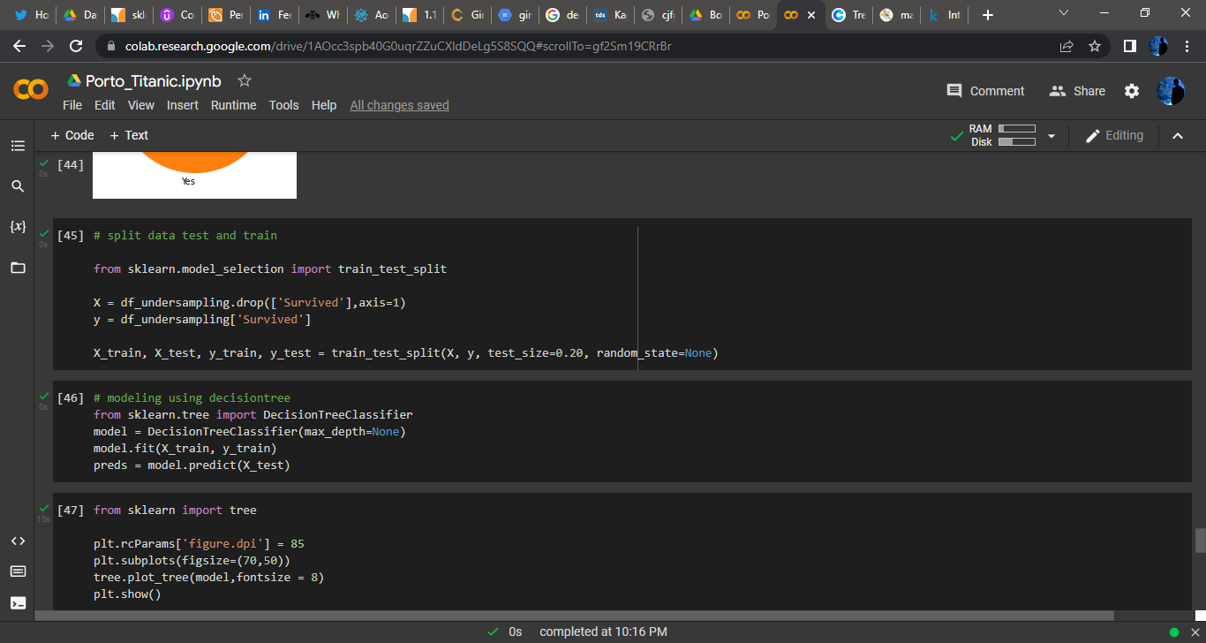
First, we split the data!
We will separate the data into 80% training data and 20% testing data. By using 80% of data, the machine learning supposes to understand characteristic of Titanic Dataset. After the machine learned, we put a test to the machine using the other 20% of data.
Dataset
Training Data
Testing Data

Slide 16
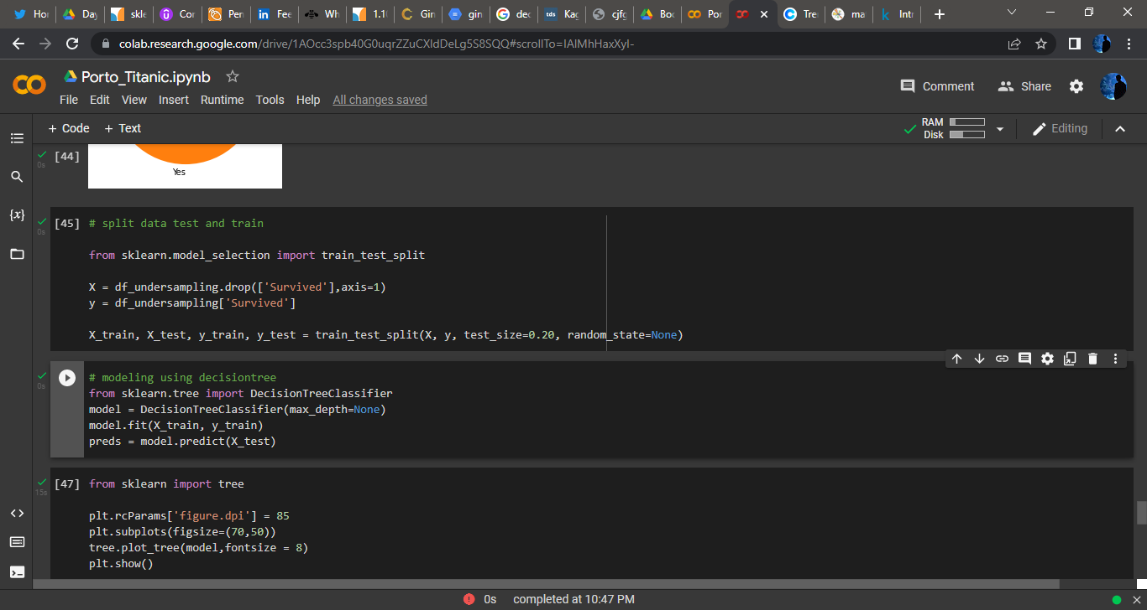
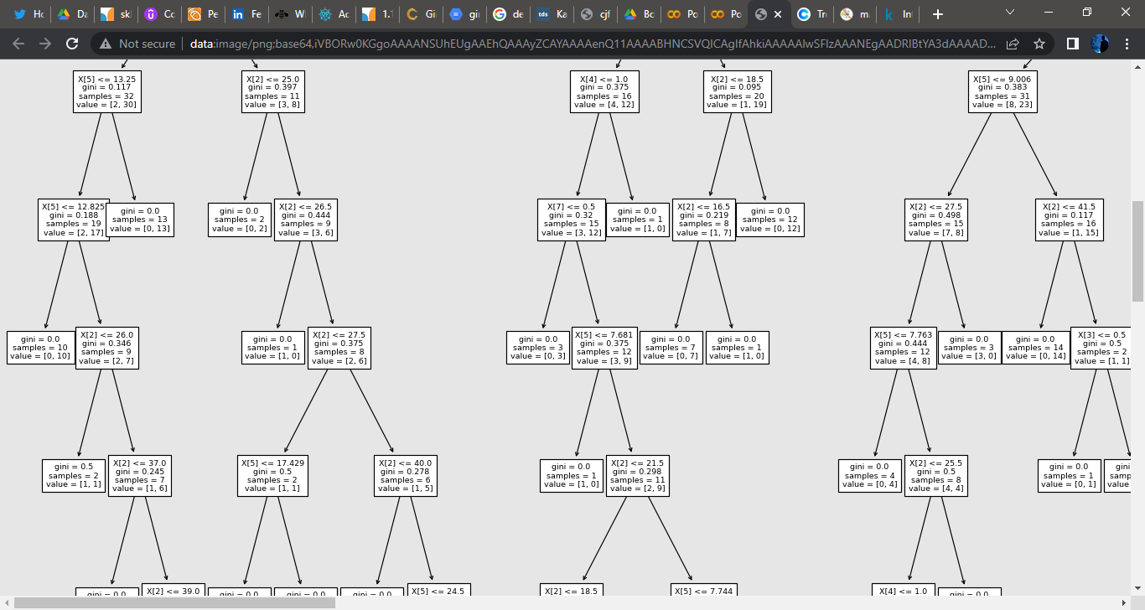
Then we applied the model!
Modelling Syntax
Modelling Trees
Decision trees classify the examples by sorting them down the tree from the root to some leaf/terminal node, with the leaf/terminal node providing the classification of the example.
Each node in the tree acts as a test case for some attribute, and each edge descending from the node corresponds to the possible answers to the test case. This process is recursive in nature and is repeated for every subtree rooted at the new node.
(Source : www.kdnuggets.com)

Slide 17
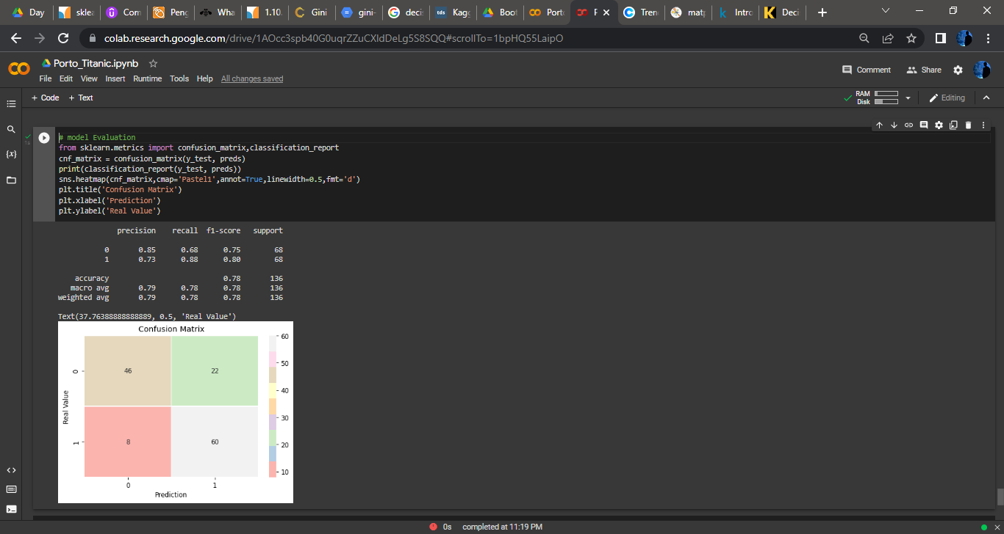
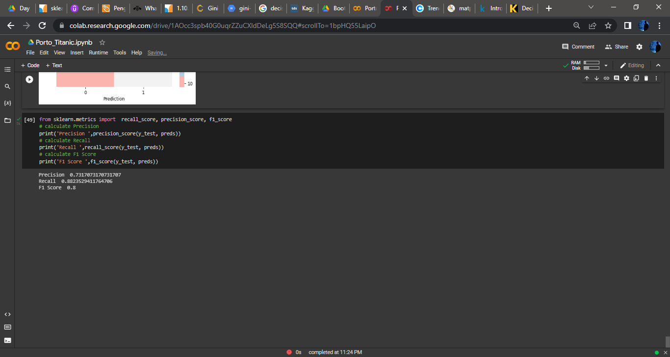
Model Evaluation
Based on the confusion matrix, our model has number of precision of 73%, number of recall, 88%, and f1-score 80%. Which means that our model is capable enough to predict new data of survived passengers, but the performance still can be improved by several method.

Slide 18
Advantages
Disadvantages
Simple to understand and to interpret. Trees can be visualized.
Requires little data preparation. Other techniques often require data normalization, dummy variables need to be created and blank values to be removed. Note however that this module does not support missing values.
The cost of using the tree (i.e., predicting data) is logarithmic in the number of data points used to train the tree.
Possible to validate a model using statistical tests. That makes it possible to account for the reliability of the model.
Performs well even if its assumptions are somewhat violated by the true model from which the data were generated.
Decision-tree learners can create over-complex trees that do not generalize the data well. This is called overfitting. Mechanisms such as pruning, setting the minimum number of samples required at a leaf node or setting the maximum depth of the tree are necessary to avoid this problem.
Decision trees can be unstable because small variations in the data might result in a completely different tree being generated. This problem is mitigated by using decision trees within an ensemble.
Decision tree learners create biased trees if some classes dominate. It is therefore recommended to balance the dataset prior to fitting with the decision tree.
(Source : https://scikit-learn.org/)

Slide 19
Resources
https://www.learndatasci.com/glossary/gini-impurity/
https://scikit-learn.org/stable/modules/tree.html
https://www.ibm.com/cloud/learn/machine-learning
https://www.kdnuggets.com/2020/01/decision-tree-algorithm-explained.html

Slide 20

Thanks
Do you have any questions?
rafiwirawan@gmail.com
linkedin.com/in/muhammadrafiwirawanputra/

